Slide 1

Proposed Conceptual Public Access Plan
Indian Mound Station Sanctuary
Brevard County Environmentally Endangered Lands Program
February 27, 2020 - 6:00 pm
Enchanted Forest Sanctuary
Management and Education Center
444 Columbia Blvd.
Titusville, FL 32780

Slide 2
Environmentally Endangered Lands Program
Mission Statement
Vision Statement
Protect and preserve biological diversity through responsible stewardship of Brevard County’s natural resources.
Acquire, protect, and maintain environmentally endangered lands.
Protect Brevard County’s biodiversity.
Provide passive recreation and education opportunities.
Support active volunteers and community involvement.

Slide 3
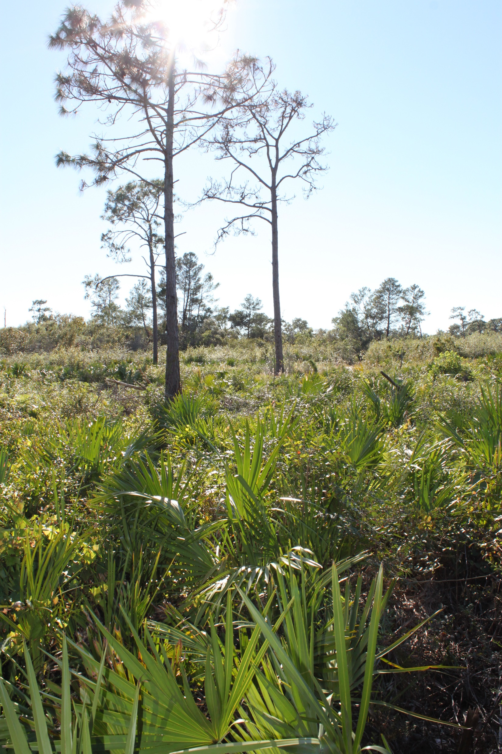
Public Access Plan Approval Process and
Opportunities for Public Comment
Public presentation of the Proposed Public Access Plan for Indian Mound Station Sanctuary.
Collect public comments on Public Access Plan.
Public comments are incorporated into the Public Access Plan and reviewed by Brevard County Environmentally Endangered Lands Program’s (EEL) Recreation and Education Advisory Committee (REAC).
Upon REAC approval, the Public Access Plan is incorporated in the draft Sanctuary Management Plan for EEL Selection and Management Committee approval.
All committee meetings are advertised and open to the public.

Slide 4
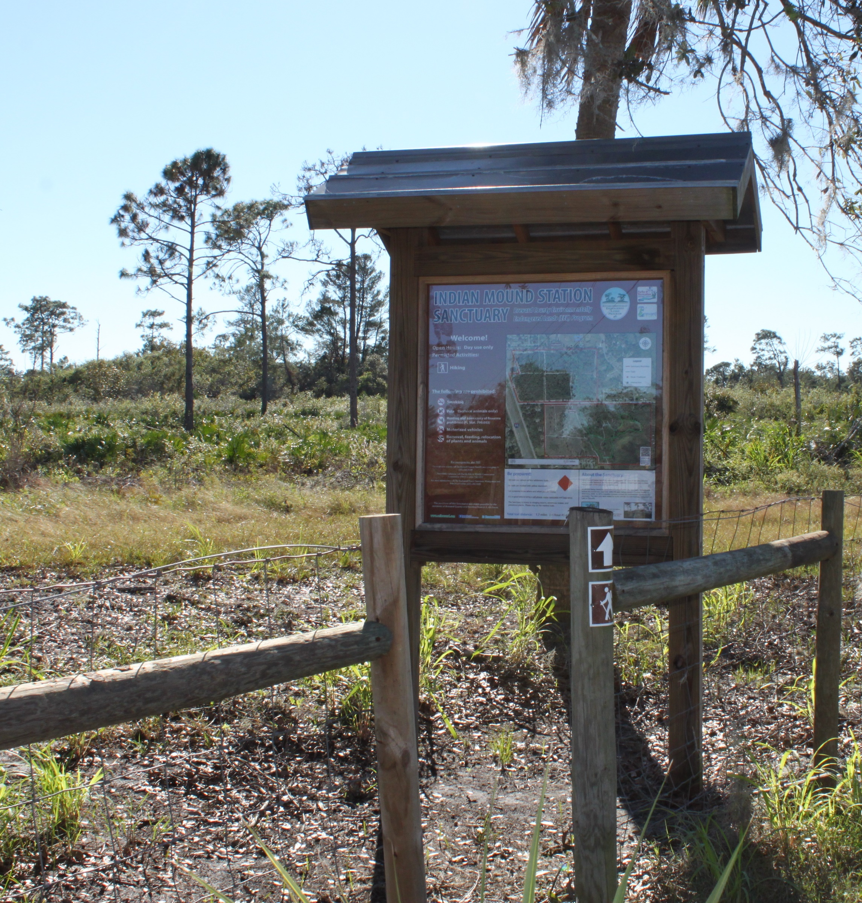
Indian Mound Station Sanctuary is a Category 2 Site
Category 2 sites within the Environmentally Endangered Lands Program are managed for intermediate use with minimal capital development. Improvements can include:
  Nature Trails
  Parking Areas
  Interpretive Signs and Kiosks
Public access during daylight hours.

Slide 5
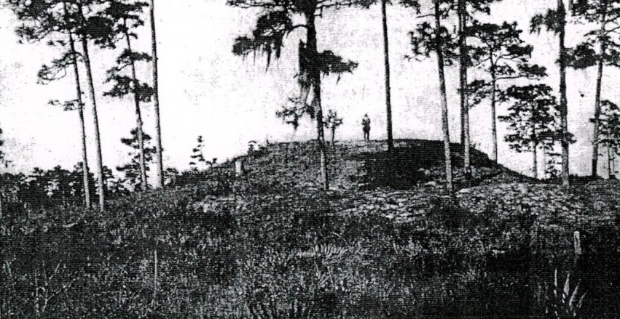
Site Description
Habitat types are oak-saw palmetto scrub, scrubby flatwoods, hydric flatwoods, and floodplain marsh.
There is an Indian Burial Mound on site that is estimated to be as old as 3000 BP to 750 AD.
Also, a portion of the St. Johns and Indian River Railroad is believed to have traversed the western side of the site.
Many scrub dependent species such as the gopher tortoise and Florida scrub-jay inhabit the site.

Slide 6
Proposed Conceptual Public Access Plan Summary
Existing trail system being modified to avoid fire lines and consistently wet portions of trail. The relatively small size of the site (145 acres), length of planned trail, and the sandy and wet soils support hiking and nature observation as permitted activities, but do not support equestrian use or bicycling.
A more recently acquired 62 acre parcel now comprises the northern half of Indian Mound Station Sanctuary. The proposed 1.6 mile trail will connect the northern and southern sections crossing Parrish Road.
A recent Eagle Scout project improved the parking area located within Holder Park providing an easy access to the trailhead.
No changes are proposed for existing kiosk locations, existing parking areas, or existing walkthrough gates.

Slide 7
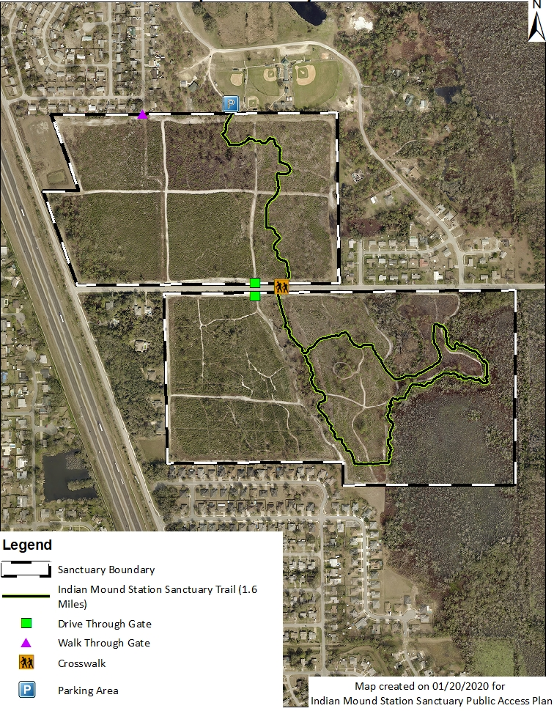
Indian Mound Station Sanctuary Proposed Trail System

