Slide 1

Valkaria Airport Master Plan Update
Public Information Meeting
February 25, 2015
Viera Government Center

Slide 2
Valkaria Airport
2015 Master Plan Update
AGENDA
  Welcome and Introductions
  2006 Airport Master Plan Refresher
  2015 Airport Master Plan Update
    Study requirements and schedule
    Review of forecasts of aviation demand
    Review preliminary facility requirements
    Next steps

Slide 3
Valkaria Airport Master Plan Update
2006 Airport Master Plan Refresher
  Required to conform to applicable FAA and FDOT standards
    a 20-year planning “road-map”
  Considered:
    existing conditions at the time of the study
    forecasts of future aviation demand
    capacity of existing facilities
    capability of existing facilities to meet forecast demand
    options for meeting future demand considering community goals, environmental conditions and financial considerations
  Recommended changes to meet FAA/FDOT guidelines

Slide 4

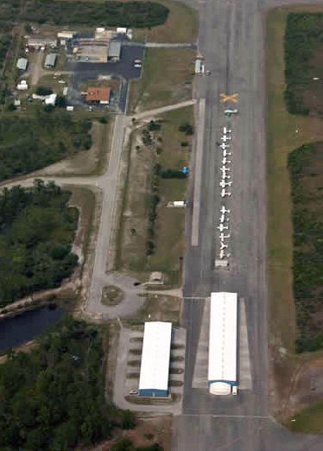
Valkaria Airport Master Plan Update
2006 Airport Master Plan Refresher
    Maintaining 2 runways that conform to FAA standards
      Marking and Signage
      Hangars, environmental and drainage
      Consider future needs for Flight safety and runway landing aids
    Full length Taxiway A parallel to Runway 14/32
      Other access taxilanes
    Aircraft storage and parking areas
    Admin. and flight services facility
    Aircraft fueling facilities
    Land use compatibility (infield)

Slide 5
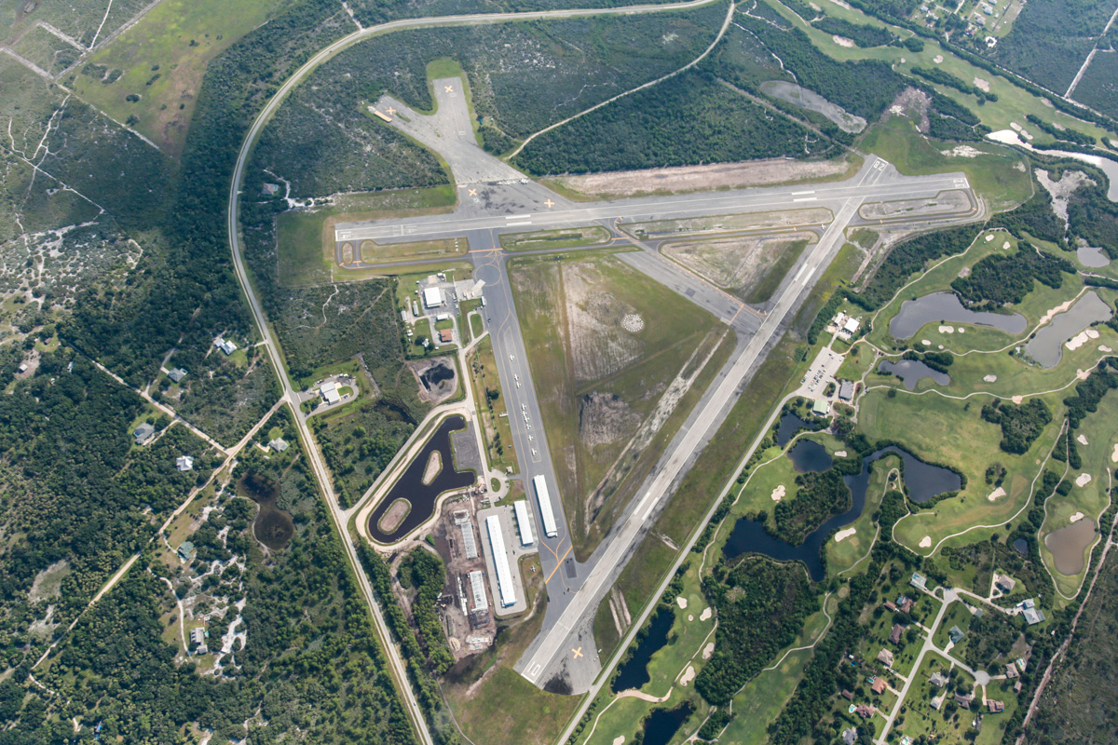
Valkaria Airport Master Plan Update
2015 Airport Master Plan Update
New Taxiway A EA and Construction
INSERT CURRENT AERIAL
Aircraft Parking Apron Rehab
Reconstruct Taxiway B
Stormwater Management/ Wetland Mitigation
Stormwater Management/ Wetland Mitigation
Runway 10-28 Rehab
New T-Hangar Complex

Slide 6
Valkaria Airport Master Plan Update
2015 Airport Master Plan Update
  Required to conform to applicable FAA and FDOT standards
    a 20-year planning “road-map”
  Schedule – Major Milestones
 | Start | Finish | Comments
Inventory & Forecasts | Oct-2014 | Nov-2014 | Agency Review Required
Demand/Capacity & Facility Requirements | Dec-2014 | Feb-2015 | Public Information Meeting
Alternatives/Environmental Review | Feb-2015 | Mch-2015 | Public Information Meeting
Final Master Plan Update | Jan-2015 | Apl-2015 | BOCC Meeting, Agency Review

Slide 7
Valkaria Airport Master Plan Update
2015 Airport Master Plan Update
  Inventory of Existing Conditions
Existing Airfield Characteristics
Runways | 14 | 32 | 10 | 28
Dimension (ft.) | 4,000’ x 75’ |  | 4,000’ x 60’
 | Primary |  | Secondary
Surface | Asphalt |  | Asphalt
Surface Condition | Fair to Poor |  | Excellent
Pavement Strength | 12,500 LBS. SW
Runway Edge Lighting | None
Threshold Lights | Both Runways
NAVAIDS | Rotating Beacon and PAPI’s
Runway Marking | Basic |  | Basic
Taxiways | 4,000’ x 25’ Parallel TWY A |  | None
Source: Airport Facility Directory, 2014; Airport Records; Master Record Form 5010; Hanson 2015

Slide 8
Valkaria Airport Master Plan Update
2015 Airport Master Plan Update
  Existing Landside Facilities
    Aircraft storage
      5 T-Hangar strands & 4 box hangars
    Rehabilitated aircraft parking apron
    & tie-downs
      30 aircraft tie-downs
    Beacon, segmented circle, CF windsock, PAPI, threshold lights
    Improved airfield drainage & addressed wildlife hazards
    Added Skyman Park
    Consolidated fuel farm
      12,000 gals. 100LL
      5,000 gals. Jet-A

Slide 9

Valkaria Airport Master Plan Update
2015 Airport Master Plan Update
  2014 FDOT Statewide Airport Economic Impact Study
  Determined economic impacts of Florida’s airport system
  Direct, indirect and induced impacts from tenant and airport business activities, projects and visitor spending
    Valkaria Airport Impacts:
      196 Total Employment
      8,268,000 Payroll
      10,013,000 Direct impacts
      1,640,000 Indirect impacts

Slide 10
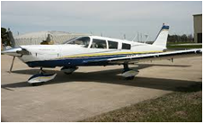
Valkaria Airport Master Plan Update
2015 Airport Master Plan Update
  Forecast of Aviation Demand (5-, 10-, and 20-year planning periods)
  Considers current level of activity (2014 base year) and estimates
    Number and type of aircraft “based” at the airport
    Number and type of aircraft “operations” (takeoffs & landings)
      Local operations, including training
      Itinerant operations
    Number of pilots and passengers
    Vehicle parking needs
    Instrument approaches
Identifies the “Design Aircraft”
Dictates airport design standards

Slide 11
Valkaria Airport Master Plan Update
2015 Airport Master Plan Update
  Forecast of Based Aircraft – Review of previous forecasts
Total Based Aircraft compared to FAA and 2006 Airport Master Plan Forecast
Year | Airport Records | FAA Forecast | 2006 Master Plan
Historical
2006 | 49 | 42 | 49
2007 | 49 | 42
2008 | 49 | 49
2009 | 49 | 74
2010 | 75 | 75
2011 | 75 | 56 | 60
2012 | 75 | 62
2013 | 84 | 64
2014 | 127 | 64
Forecast
2011 |  | 56 | 60
2016 |  | 66 | 69
2026 |  | 80 | 86
Source: Airport Records, FAA TAF 2013; 2006 Airport Master Plan, Hanson 2015

Slide 12
Valkaria Airport Master Plan Update
2015 Airport Master Plan Update
Forecast Methodologies
  Based Aircraft
  National Growth Rate – Applies the Federal Aviation Administration (FAA) projected national growth rate.
  Market Share – Applies the FAA projected percentage of national active aircraft.
  Terminal Area Forecast (TAF) – Accept the FAA projections developed specifically for X59.
  Florida Department of Transportation (FDOT) – Accept the FDOT projections specially developed for X59.

Slide 13
Valkaria Airport Master Plan Update
2015 Airport Master Plan Update
Forecasts of Aviation Demand
  Based Aircraft
Preferred Forecast
Forecast Model
Years | Actual | Trend Analysis | Market Share | Nat. Growth Rate | TAF | FDOT
2006 | 49
2007 | 49
2008 | 49
2009 | 49
2010 | 75
2011 | 75
2012 | 75
2013 | 84
2014 | 127 | 127 | 127 | 127 | 42
Forecast
2019 |  | 187 | 128 | 130 | 70 | 87
2024 |  | 202 | 138 | 133 | 76 | 94
2034 |  | 236 | 141 | 138 | 96 | 109
TAF forecast based upon inaccurate 2014 based aircraft count
Assumes maintaining market share at .06255% over the planning horizon
FDOT forecast based upon TAF 2014 based aircraft count
Assumes a 1.56% increase per year over the planning horizon
Assumes a 0.5% increase per year over the planning horizon

Slide 14



Valkaria Airport Master Plan Update
2015 Airport Master Plan Update
Forecast Based Aircraft Fleet
Forecast Based Aircraft, By Type
 | Year
Aircraft Category | 2014 | 2019 | 2024 | 2034
Single-Engine Piston | 95 | 139 | 151 | 177
Multi-Engine | 4 | 6 | 7 | 7
Jet | 0 | 1 | 1 | 2
Helicopter | 6 | 10 | 11 | 13
Others | 21 | 31 | 32 | 37
Total | 127 | 187 | 202 | 236

Slide 15
Valkaria Airport Master Plan Update
2015 Airport Master Plan Update
Forecasts Methodologies
  Operations
    Operations to Based Aircraft (OPBA) – Developed based upon a ratio of operations to based aircraft.
  FAA TAF – 2014 projections developed specifically for X59.
  FDOT – 2014 projections specially developed for X59.
    Historical Growth Rate vs. FAA Aerospace Forecast
    ⧫ Historical growth at X59 was 5.2% over 9 years;
    ⧫ 2006 Airport Master Plan projected 3.7% over 20 years;
    ⧫ FAA National forecast forecasts avg. annual growth of 1.4% thru 2034;
    ⧫ 2014 Florida Aviation System Plan forecasts avg. annual growth of 1% thru 2034;
    ⧫ 2015 Airport Master Plan forecasts avg. annual growth of 1% over 20 years;

Slide 16
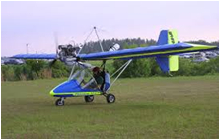
Valkaria Airport Master Plan Update
2015 Airport Master Plan Update
Forecasts of Aviation Demand
  Aircraft Operations
Annual Aircraft Operations Forecast
Year | No. of Aircraft Operations
2014 | 53,160
Forecast
2019 | 55,872
2024 | 58,722
2034 | 64,865
Aircraft Operations
Year | Local | Itinerant
2014 | 74% | 26%
Forecast
2019 | 74% | 26%
2024 | 74% | 26%
2034 | 74% | 26%

Slide 17
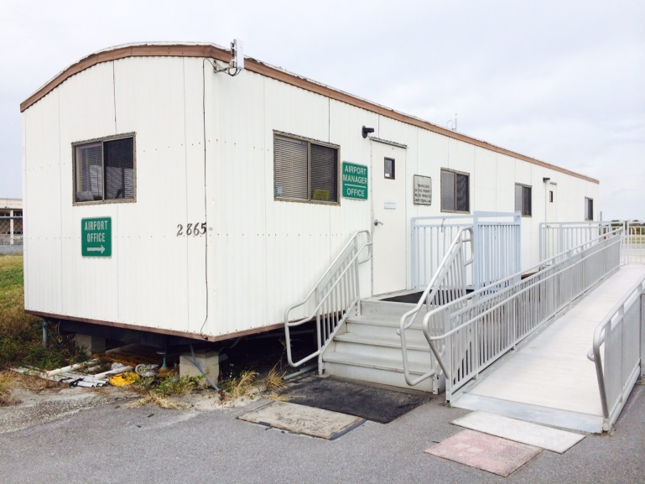
Valkaria Airport Master Plan Update
2015 Airport Master Plan Update
Forecasts of Aviation
  Pilots and Passengers
    Peak hour of 30 aircraft with an average of 2.5 passengers each
  Design Aircraft
    2006 Airport Master Plan = B-II
      Beechcraft King Air
    2015 Airport Master Plan Update = B-II (no change)
Existing Admin. Trailer

Slide 18
Valkaria Airport Master Plan Update
2015 Airport Master Plan Update
Preliminary Facility Requirements
  Airside Facilities
  Runways
    Secondary Runway 10/28 meets projected needs
    Primary Runway 14/32 needs:
      Rehabilitate pavement and meet standards
      Navigation aids, landing aids, edge lights and proper signage
  Taxiways
    Widen Taxiway A from 25 ft. to 35 ft. to meet standards
    Plan a connector taxiway to improve access to T-Hangars
    Plan a taxiway to access golf course aircraft parking

Slide 19
Valkaria Airport Master Plan Update
2015 Airport Master Plan Update
Preliminary Facility Requirements
  Landside Facilities
  2034 Based Aircraft forecast exceeds current aircraft parking and storage capacity
    Need for additional hangars
    Need for additional tie down spaces
  Pilots/passengers and admin. needs support 2006 Master Plan recommendations
    Administrative building & flight services facility
    Additional auto parking
  Plan a connector from the Fire Station to the airfield
  Fuel storage facilities
    Avgas storage meets needs
    Jet-A storage meets needs

Slide 20
Valkaria Airport Master Plan Update
2015 Airport Master Plan Update
Next Steps
  Complete facility requirements narrative
  Develop alternative methods/locations of facilities to accommodate future demand
    Review potential environmental impacts
  Continue Airport Layout Plan development
  Develop financial analysis and Capital Improvement Plan (CIP)
  Finalize Master Plan Update

Slide 21
Valkaria Airport Master Plan Update
2015 Airport Master Plan Update
INSERT CURRENT AERIAL

